Slide 1

CS 533 INTRO TO DATA SCIENCE
Michael Ekstrand

Slide 2
LOSS AND OPTIMIZATION

Slide 3

Learning Outcomes
Understand a loss function
Optimize model for a loss function
See attached notebook for code!
Photo by Nick Reynolds on Unsplash

Slide 4
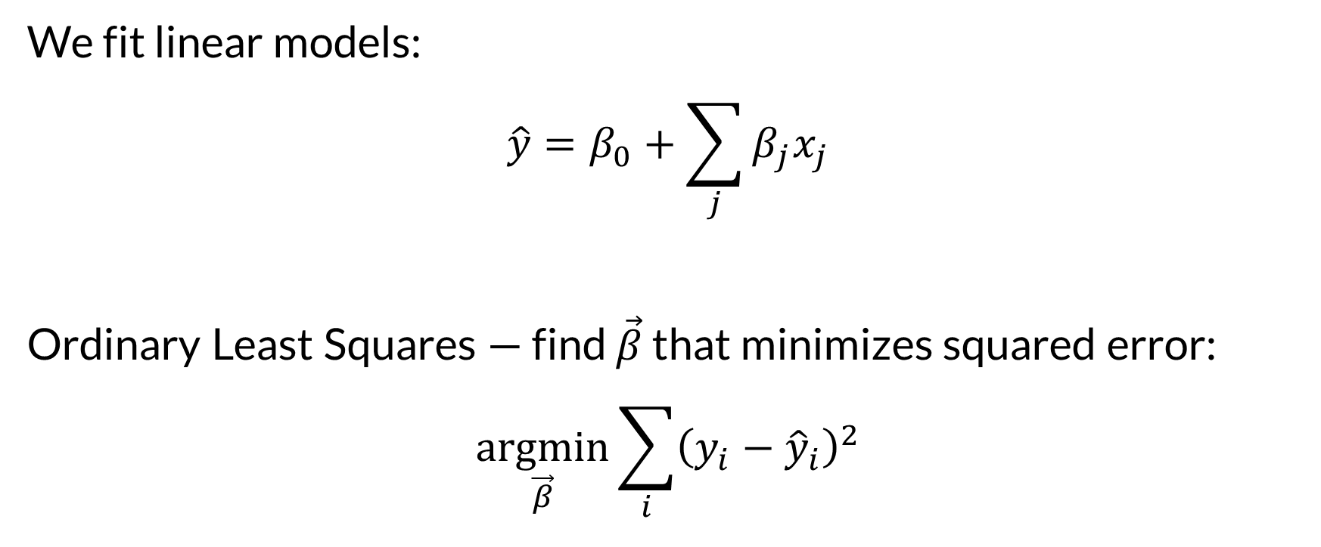
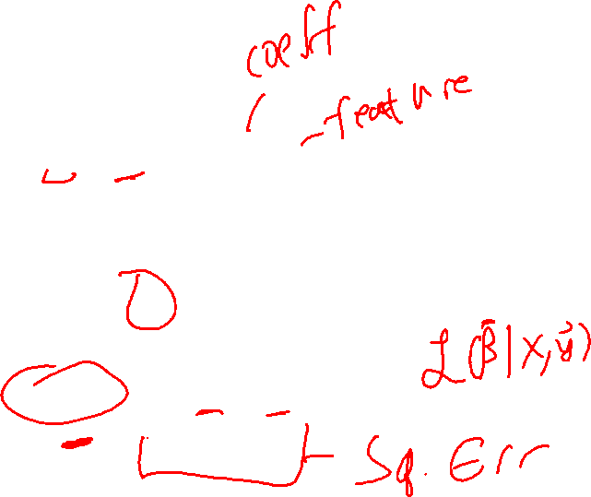
Least Squares Regression
We fit linear models:
$$\hat{y}=β_{0}+\sum_{j}{β_{j}x_{j}}$$
Ordinary Least Squares — find $\vec{β}$ that minimizes squared error:
$$\underset{\vec{β}}{argmin}{\sum_{i}{{\left({y_{i}−\hat{y}}_{i}\right)}^{2}}}$$

Slide 5

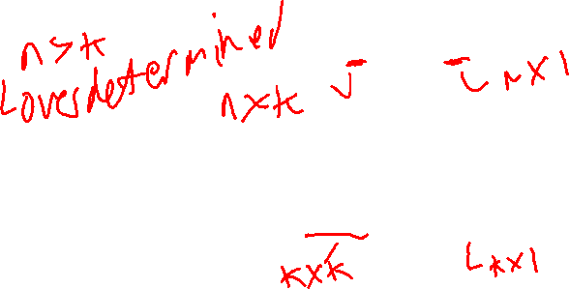
Solve Least Squares
Goal: least-squares solution to:
$$X\vec{β}=\vec{y}$$
Solution: solve the normal equations
$$X^{T}X\vec{β}=X^{T}\vec{y}$$
But we can be more general.

Slide 6
Minimization
Many problems are minimization (or maximization) problems!
scipy.optimize provides a minimize function

Slide 7
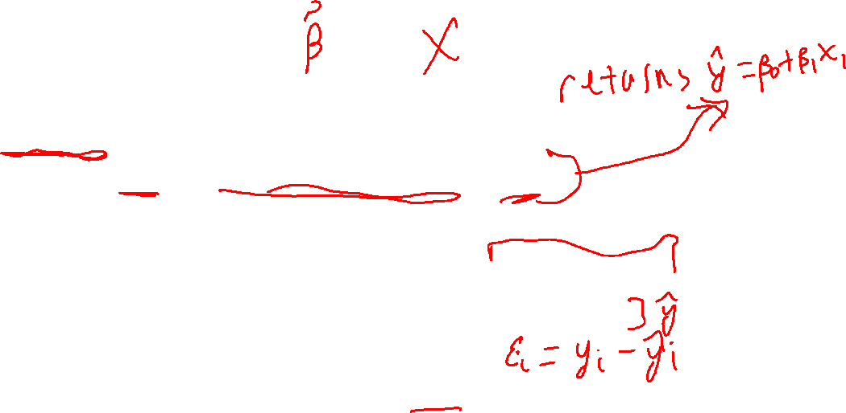
Model and Loss
def predict_mass_uv(params, data): b0, b1 = params return b0 + data['flipper'] * b1
def squared_loss_uv(params, data=penguin_std): preds = predict_mass_uv(params, data) err = data['mass'] - preds return np.sum(np.square(err))

Slide 8

Minimization
from scipy.optimize import minimize
init_guess = rng.standard_normal(2)
result = minimize(squared_loss_uv, init_guess)
# get model parameters result.x array([1.12829633e-09, 8.71201757e-01])

Slide 9
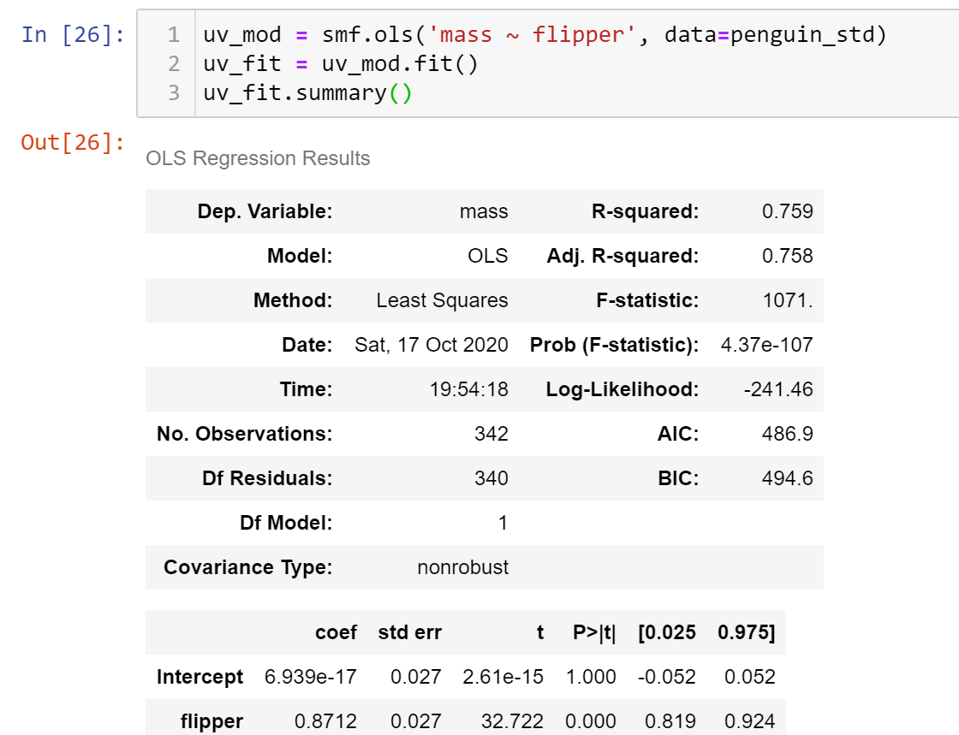

Statsmodel OLS model

Slide 10
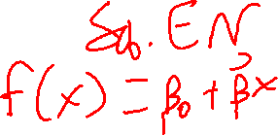
General Optimization
Understand data (features and outcome variables)
Define loss (or gain/utility) function
Define predictive model
Search for parameters that minimize loss function

Slide 11
Train and Test
We optimize the loss function on the train data
Evaluate on the test data
Sometimes loss function is eval; sometimes not
Mean squared error: often used for both

Slide 12
Augmented Loss
We can add more things to the loss function
Penalize model complexity
Penalize “strong” beliefs
Requires predictive utility to overcome them

Slide 13

Wrapping Up
Least squares generalizes into minimizing loss functions.
This is the heart of machine learning, particularly supervised learning.
Photo by Mitchell Luo on Unsplash

